Slide 1

Topic 15
Electric Forces and Fields
(Part – 2)

Slide 2
Objectives
Understand the basic properties of electric charges.
Apply Coulomb’s Law to calculate the electric force between charged particles.
Describe and calculate the relationship between electric force and electric field for a point charge.
To draw the electric field lines for electric charge.

Slide 3
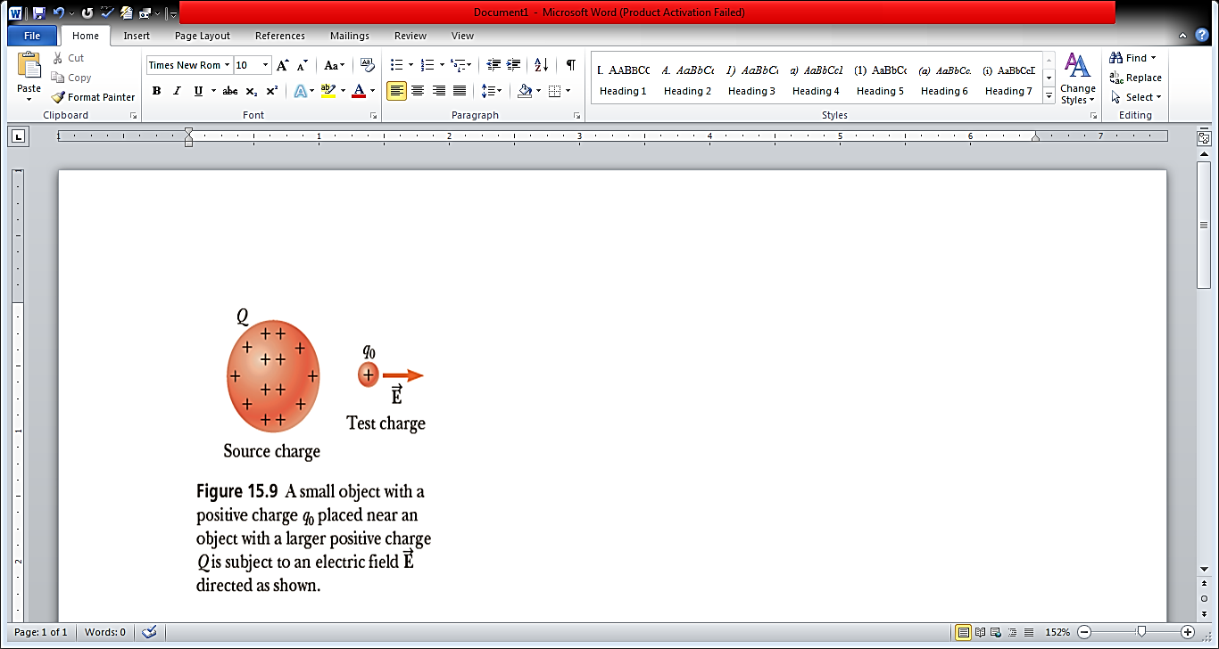
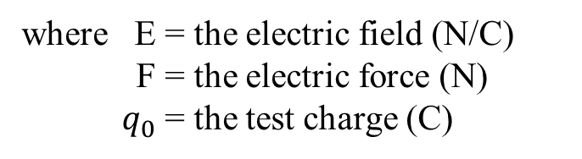
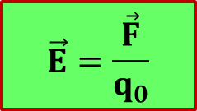
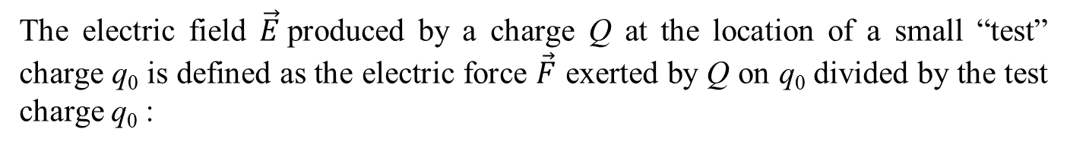
15.3 Electric Fields
The electric field $\vec{E}$produced by a charge Q at the location of a small “test” charge q₀ is defined as the electric force $\vec{F}$ exerted by Q on q₀ divided by the test charge q₀ :
$$\vec{E}=\frac{\vec{F}}{q_{0}}$$
where E = the electric field (N/C)
F = the electric force (N)
${ q}_{0}$= the test charge (C)

Slide 4
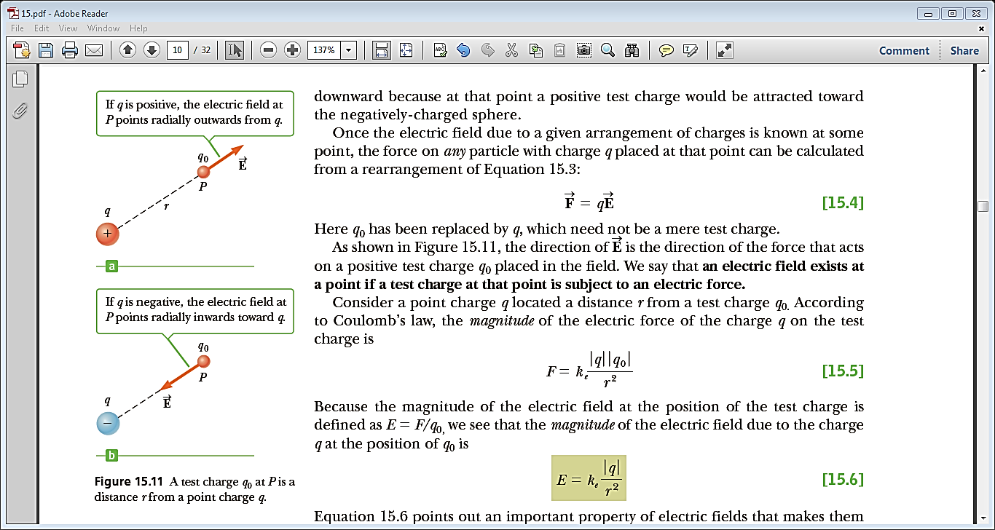
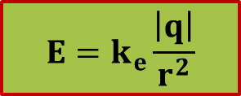
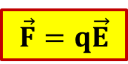
$$E=k_{e}\frac{\left|q\right|}{r^{2}}$$
$$\vec{F}=q\vec{E}$$
Note - $q_{0}$has been replaced by q, which need not be a mere test charge.
Figure 15.11 A test charge q₀ at P is a distance r from a point charge q.

Slide 5
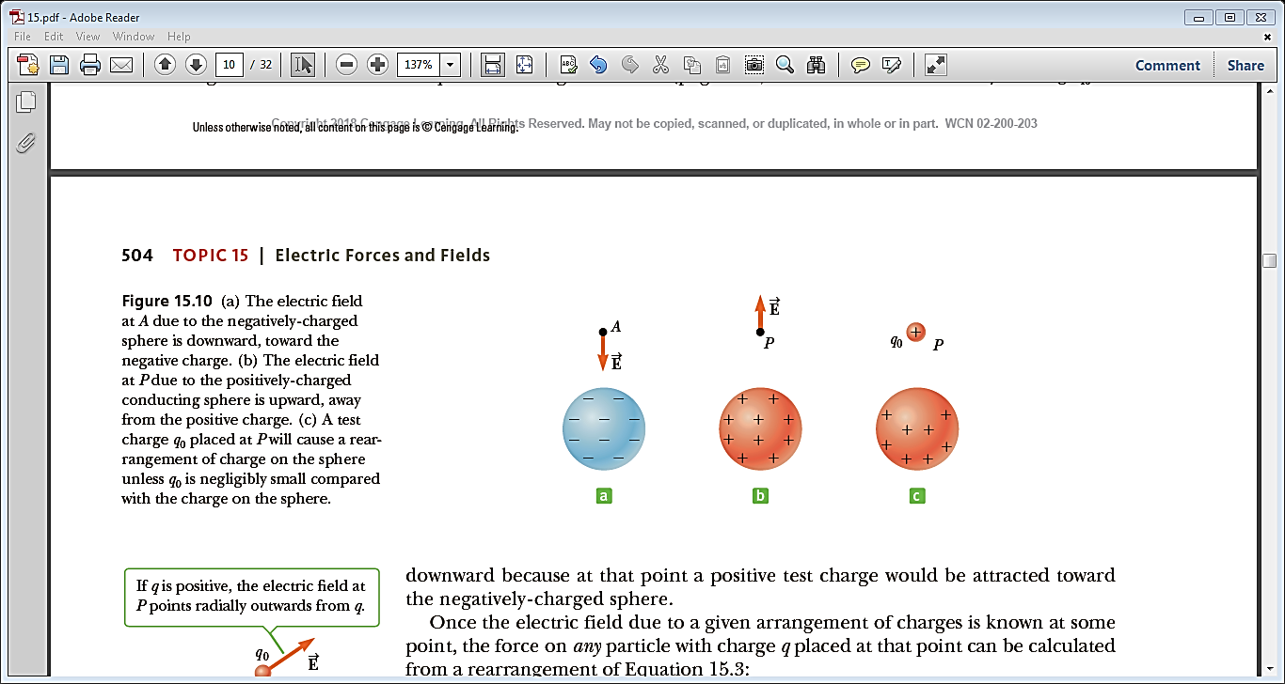
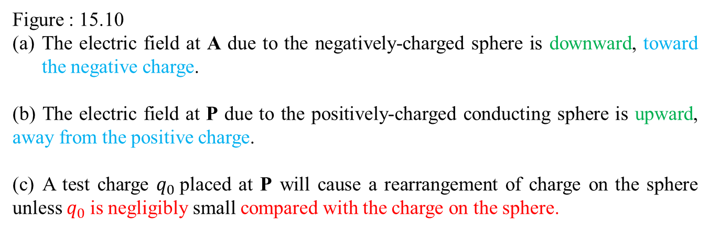
Figure : 15.10
The electric field at A due to the negatively-charged sphere is downward, toward the negative charge.
(b) The electric field at P due to the positively-charged conducting sphere is upward, away from the positive charge.
(c) A test charge $q_{0}$placed at P will cause a rearrangement of charge on the sphere unless $q_{0}$is negligibly small compared with the charge on the sphere.

Slide 6
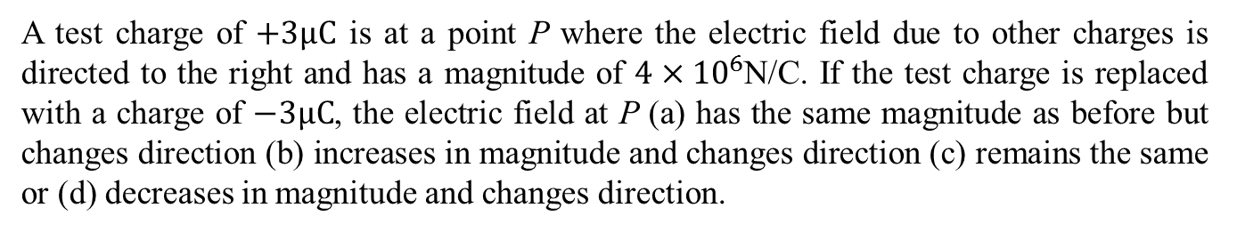
Quick Quiz - 15.3
A test charge of $+3μC$ is at a point P where the electric field due to other charges is directed to the right and has a magnitude of $4×{10}^{6}$N/C. If the test charge is replaced with a charge of $−3μC$, the electric field at P (a) has the same magnitude as before but changes direction (b) increases in magnitude and changes direction (c) remains the same or (d) decreases in magnitude and changes direction.
Answer - (c)
The electric field at point P is due to charges other than the test charge. Thus, it is unchanged when the test charge is altered. However, the direction of the force this field exerts on the test change is reversed when the sign of the test charge is changed.

Slide 7
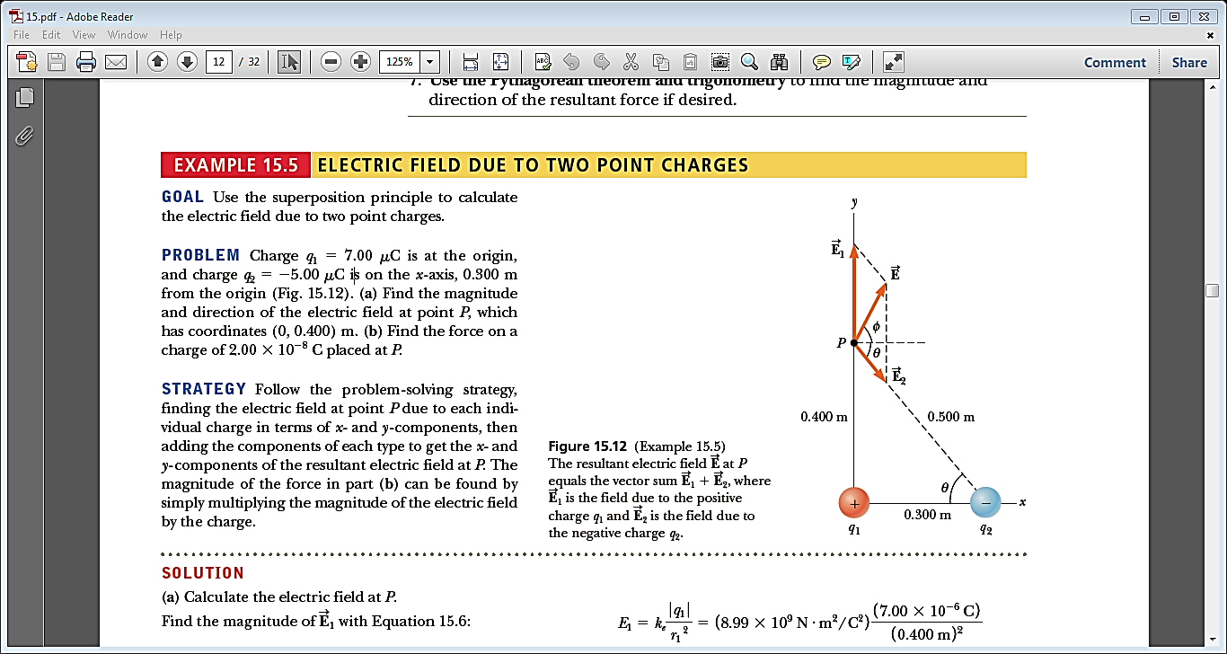
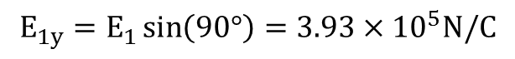
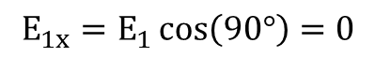
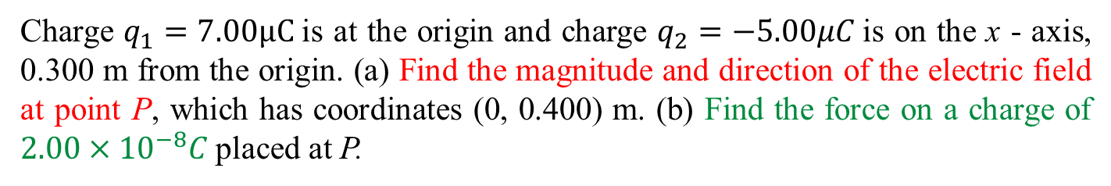
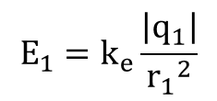
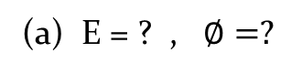
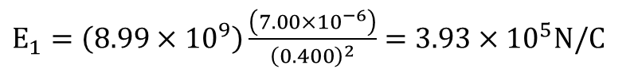
Example-15.5
Charge $q_{1}=7.00μC$is at the origin and charge $q_{2}=−5.00μC$is on the x - axis, 0.300 m from the origin. (a) Find the magnitude and direction of the electric field at point P, which has coordinates (0, 0.400) m. (b) Find the force on a charge of $2.00×{10}^{−8}C$placed at P.
Solution,
(a) E = ? , $∅=?$
$$E_{1}=k_{e}\frac{\left|q_{1}\right|}{{r_{1}}^{2}}$$
$E_{1}=\left(8.99×{10}^{9}\right)\frac{\left(7.00×{10}^{−6}\right)}{{\left(0.400\right)}^{2}}=3.93×{10}^{5}N/C$
$$E_{1x}=E_{1}\cos\left(90°\right)=0$$
$$E_{1y}=E_{1}\sin\left(90°\right)=3.93×{10}^{5}N/C$$

Slide 8
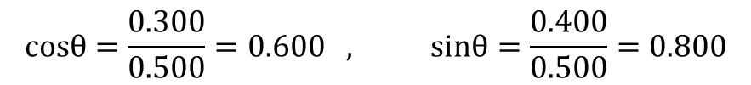
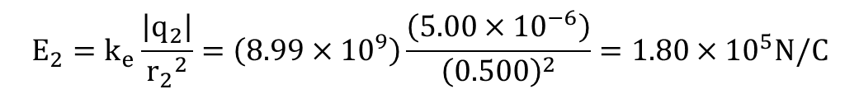
$$E_{2}=k_{e}\frac{\left|q_{2}\right|}{{r_{2}}^{2}}=\left(8.99×{10}^{9}\right)\frac{\left(5.00×{10}^{−6}\right)}{{\left(0.500\right)}^{2}}=1.80×{10}^{5}N/C$$
$$cosθ=\frac{0.300}{0.500}=0.600 , sinθ=\frac{0.400}{0.500}=0.800$$
$$E_{2x}=E_{2}cosθ=\left(1.80×{10}^{5} \right)\left(0.600\right)=1.08×{10}^{5}N/C$$
$$E_{2y}=E_{2}sinθ=\left(1.80×{10}^{5} \right)\left(−0.800\right)=−1.44×{10}^{5}N/C$$

Slide 9
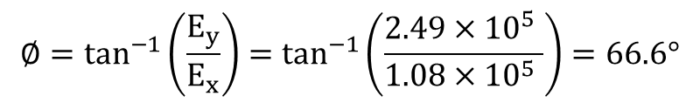
$$E_{x}=E_{1x}+E_{2x}=0+\left(1.08×{10}^{5}\right)=1.08×{10}^{5}N/C$$
$$E_{y}=E_{1y}+E_{2y}=\left(3.93×{10}^{5}\right)−\left(1.44×{10}^{5}\right)=2.49×{10}^{5}N/C$$
$$E=\sqrt{{E_{x}}^{2}+{E_{y}}^{2}}=\sqrt{{\left(1.08×{10}^{5} \right)}^{2}+{\left(2.49×{10}^{5} \right)}^{2}}=2.71×{10}^{5}N/C$$
$$∅=\tan^{−1}\left(\frac{E_{y}}{E_{x}}\right)=\tan^{−1}\left(\frac{2.49×{10}^{5} }{1.08×{10}^{5} }\right)=66.6°$$
(b) F = ? , q = $2.00×{10}^{−8}C$
$$F=qE=\left(2.00×{10}^{−8}\right)\left(2.71×{10}^{5} \right)=5.42×{10}^{−3}N$$

Slide 10
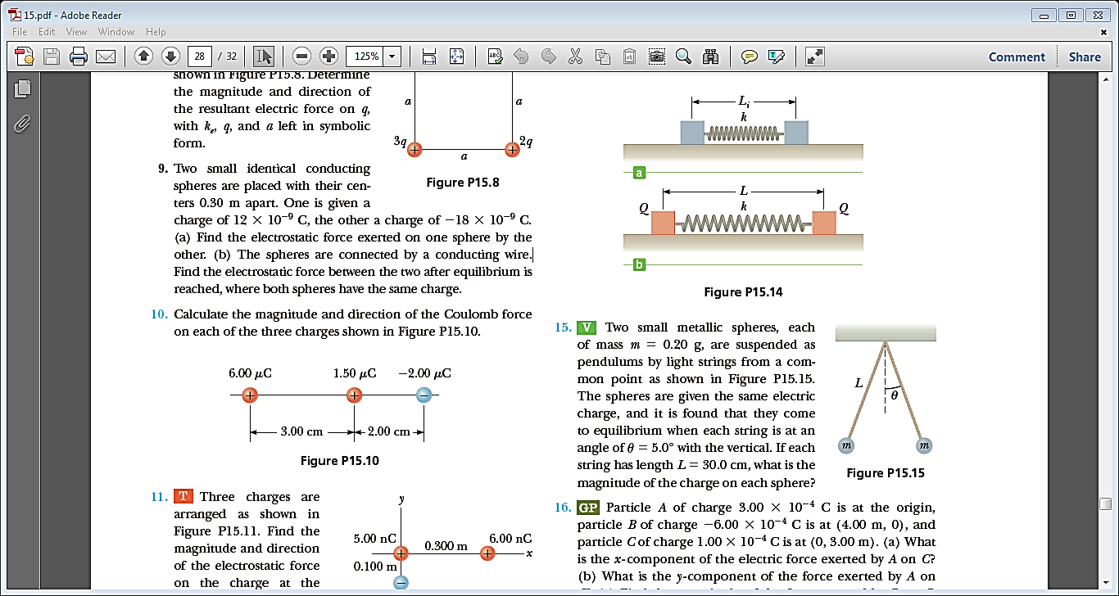
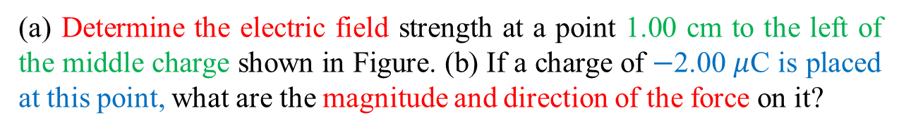
Problem-18
(a) Determine the electric field strength at a point 1.00 cm to the left of the middle charge shown in Figure. (b) If a charge of $−$2.00 $μ$C is placed at this point, what are the magnitude and direction of the force on it?

Slide 11
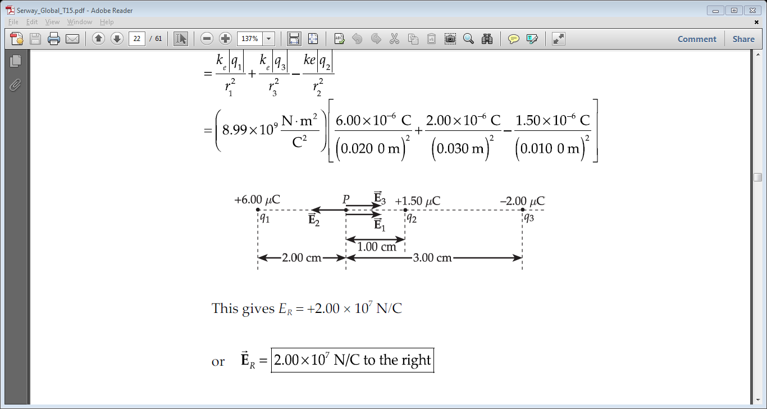
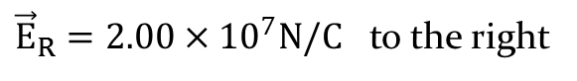
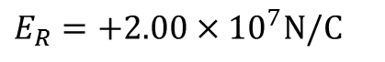
Solution,
(a) E=? ( at P )
$$E_{R}=E_{1}−E_{2}+E_{3}$$
$E_{R}=k_{e}\frac{\left|q_{1}\right|}{{r_{1}}^{2}}−k_{e}\frac{\left|q_{2}\right|}{{r_{2}}^{2}}$+ $k_{e}\frac{\left|q_{3}\right|}{{r_{3}}^{2}}$
$E_{R}=\left(8.99×{10}^{9}\right)\left[\frac{\left(6.00×{10}^{−6}\right)}{{\left(0.02\right)}^{2}}−\frac{\left(1.50×{10}^{−6}\right)}{{\left(0.01\right)}^{2}}+\frac{\left(2.00×{10}^{−6}\right)}{{\left(0.03\right)}^{2}}\right]$
$E_{R}=+2.00×{10}^{7}N/C$
${\vec{E}}_{R}=2.00×{10}^{7}N/C$ to the right

Slide 12
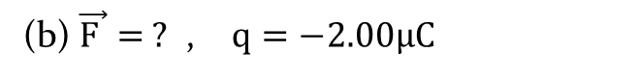
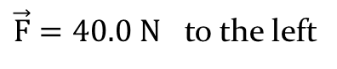
(b) $\vec{F }= ?$ , $q=−2.00μC$
$$\vec{F}=q{\vec{E}}_{R}=\left(−2.00×{10}^{−6}\right)\left(2.00×{10}^{7}\right)=−40.0 N$$
$\vec{F}=40.0 N$ to the left

Slide 13
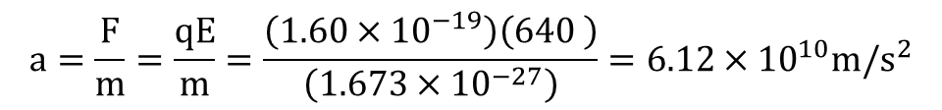
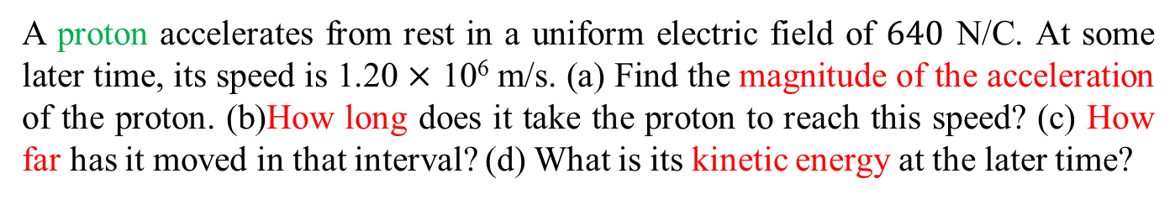
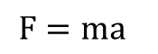
Problem-25
A proton accelerates from rest in a uniform electric field of $640$ N/C. At some later time, its speed is 1.20 $×$ 10⁶ m/s. (a) Find the magnitude of the acceleration of the proton. (b)How long does it take the proton to reach this speed? (c) How far has it moved in that interval? (d) What is its kinetic energy at the later time?
Solution,
E $=640N/C$, $v_{f}=1.20×{10}^{6}m/s$ , $v_{i}=0$ (rest)
(a) a = ?
$$F=ma$$
$$a=\frac{F}{m}=\frac{qE}{m}=\frac{\left(1.60×{10}^{−19}\right)\left(640 \right)}{\left(1.673×{10}^{−27}\right)}=6.12×{10}^{10}m/s^{2}$$

Slide 14
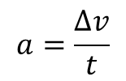
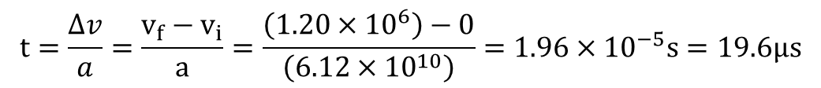
(b) t = ?
$$a=\frac{∆v}{t}$$
$$t=\frac{∆v}{a}=\frac{v_{f}−v_{i}}{a}=\frac{\left(1.20×{10}^{6}\right)−0}{\left(6.12×{10}^{10}\right)}=1.96×{10}^{−5}s=19.6μs$$

Slide 15
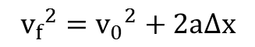
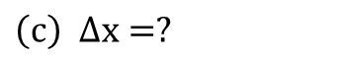
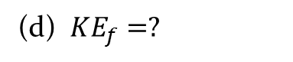
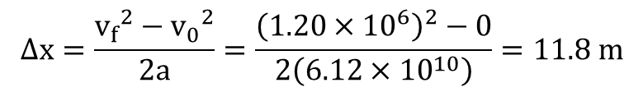
$$\left(c\right) ∆x=?$$
$${v_{f}}^{2}={v_{0}}^{2}+2a∆x$$
$$∆x=\frac{{v_{f}}^{2}−{v_{0}}^{2}}{2a}=\frac{{\left(1.20×{10}^{6}\right)}^{2}−0}{2\left(6.12×{10}^{10}\right)}=11.8 m$$
(d) ${KE}_{f}=?$
$${KE}_{f}=\frac{1}{2}m_{p}{v_{f}}^{2}=\frac{1}{2}\left(1.673×{10}^{−27}\right){\left(1.20×{10}^{6}\right)}^{2}=1.20×{10}^{−15} J$$

Slide 16
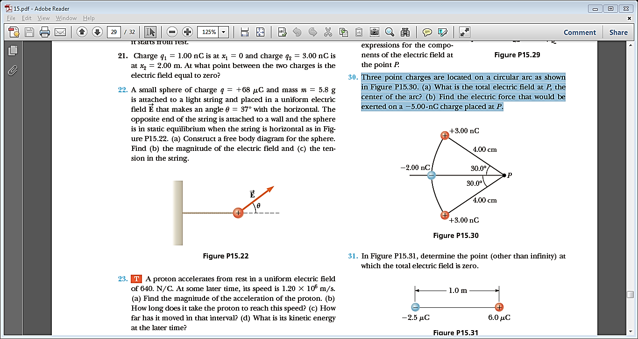
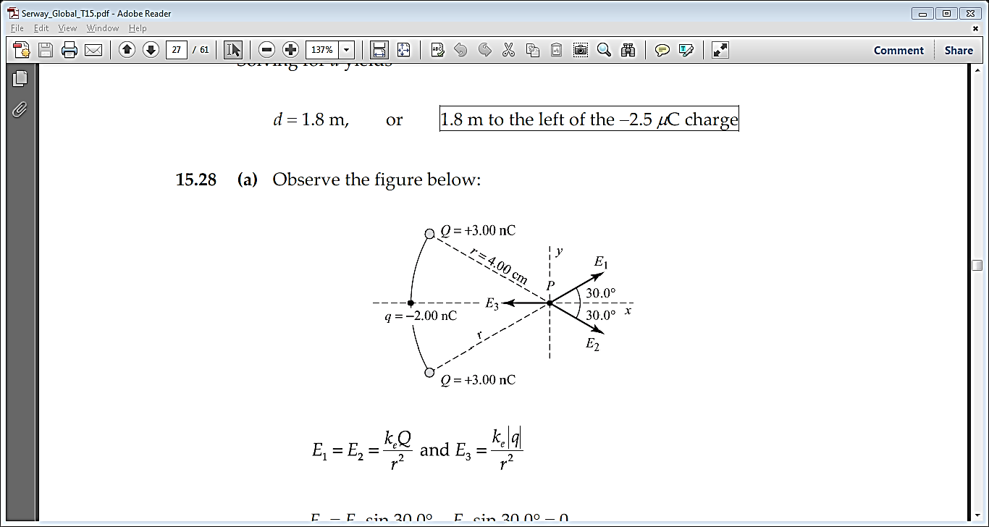
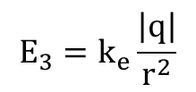
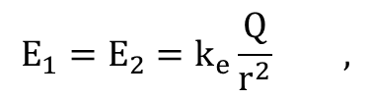
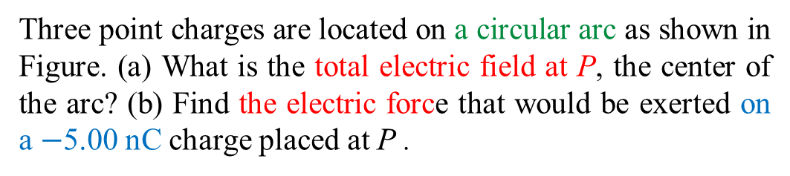
Problem-28
Three point charges are located on a circular arc as shown in Figure. (a) What is the total electric field at P, the center of the arc? (b) Find the electric force that would be exerted on a $−$5.00 nC charge placed at P .
Solution,
(a) E = ? ( at P )
$$E_{1}=E_{2}=k_{e}\frac{Q}{r^{2}} ,$$
$$E_{3}=k_{e}\frac{\left|q\right|}{r^{2}}$$
$$E_{y}=E_{1y}−E_{2y}=E_{1}sin30°−E_{2}sin30°=0$$

Slide 17
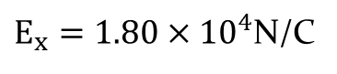
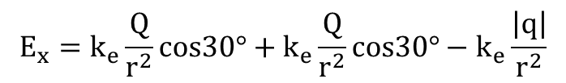
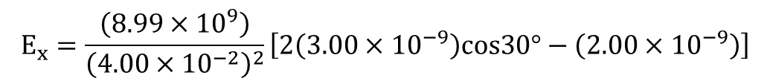
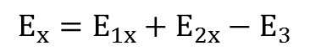
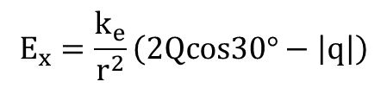
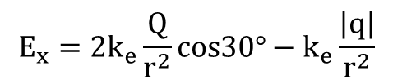
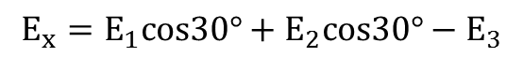
$$E_{x}=E_{1x}+E_{2x}−E_{3}$$
$$E_{x}=E_{1}cos30°+E_{2}cos30°−E_{3}$$
$$E_{x}=k_{e}\frac{Q}{r^{2}}cos30°+k_{e}\frac{Q}{r^{2}}cos30°−k_{e}\frac{\left|q\right|}{r^{2}}$$
$$E_{x}=2k_{e}\frac{Q}{r^{2}}cos30°−k_{e}\frac{\left|q\right|}{r^{2}}$$
$$E_{x}=\frac{k_{e}}{r^{2}}\left(2Qcos30°−\left|q\right|\right)$$
$$E_{x}=\frac{\left(8.99×{10}^{9}\right)}{{\left(4.00×{10}^{−2}\right)}^{2}}\left[2\left(3.00×{10}^{−9}\right)cos30°−\left(2.00×{10}^{−9}\right)\right]$$
$E_{x}=1.80×{10}^{4}$N/C

Slide 18
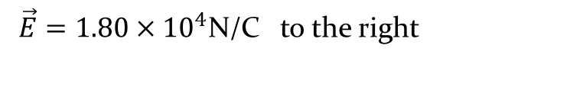
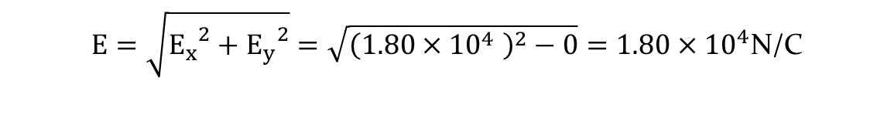

$$E=\sqrt{{E_{x}}^{2}+{E_{y}}^{2}}=\sqrt{{\left(1.80×{10}^{4} \right)}^{2}−0}=1.80×{10}^{4}\text{N}\text{/}\text{C}$$
$\vec{E}=1.80×{10}^{4}\text{N}\text{/}\text{C}$ to the right
(b) ${\vec{ F}}_{e}=? , q=−5.00nC$
$$F_{e}=qE=\left(−5.00×{10}^{−9}\right)\left(1.80×{10}^{4} \right)=−9.00×{10}^{−5}N$$
${\vec{F}}_{e}=9.00×{10}^{−5} N$ to the left

Slide 19

15.4 Electric Field Lines
The electric field in any region of space in the following way:
The electric field vector $\vec{E}$is tangent to the electric field lines at each point.
The number of lines per unit area through a surface perpendicular to the lines is proportional to the strength of the electric field in a given region.
Note that $\vec{E}$is large when the field lines are close together and small when the lines are far apart.

Slide 20

Electric Field Lines
The lines for a group of point charges must begin on positive charges and end on negative charges. In the case of an excess of charge, some lines will begin or end infinitely far away.
2. The number of lines drawn leaving a positive charge
or ending on a negative charge is proportional to the
magnitude of the charge.
3. No two field lines can cross each other.
Figure - 15.13 (a), (b) The electric field lines for a point charge

Slide 21


Figure 15.14 - The electric field lines for two equal and opposite point charges (an electric dipole).
Figure 15.16 - The electric field lines for a point charge of +2q and a second point charge of -q.

Slide 22

Figure 15.15 - The electric field lines for two positive point charges. The points A, B, and C are discussed in Quick Quiz 15.6.
Note - At points very near either charge, the lines are nearly radial. The high density of lines between the charges indicates a strong electric field in this region.

Slide 23
Quick Quiz - 15.6
Rank the magnitudes of the electric field at points A, B, and C in Figure with the largest magnitude first. (a) A, B, C (b) A, C, B (c) C, A, B (d) The answer can’t be determined by visual inspection.
Answer - (a)
The field is greatest at point A because this is where the field lines are closest together. The absence of lines at point C indicates that the electric field there is zero.

Slide 24


Problem-34
(a) Sketch the electric field pattern around two positive point charges of magnitude 1 $μ$C placed close together. (b) Sketch the electric field pattern around two negative point charges of $−$2 $μ$C, placed close together. (c) Sketch the pattern around two point charges of +1 $μ$C and $−$2 $μ$C, placed close together.
Rough sketches for these charge configurations are shown below.

Slide 25



Problem-36
Figure shows the electric field lines for two point charges separated by a small distance. (a) Determine the ratio q₁/q₂. (b) What are the signs of q₁ and q₂?
Answer:
The magnitude of $q_{2}$ is three times the magnitude of $q_{1}$ because $3$ times as many lines emerge from $q_{2}$ as enter $q_{1}$. So, $\left|q_{2}\right|=3\left|q_{1}\right|$ .
$$\left(a\right) \frac{q_{1}}{q_{2}}=− \frac{1}{3}$$
$\left(b\right) q_{2}$ is positive. ( $q_{2}>0$ because lines emerge from it)
$q_{1}$ is negative. ( $q_{1}<0$ because lines terminate on it)

Slide 26
15.5 Conductors in Electrostatic Equilibrium
When no net motion of charge occurs within a conductor, the conductor is said to be in electrostatic equilibrium.
Properties of an Isolated Conductor
The electric field is zero everywhere inside the conducting material.
Any excess charge on an isolated conductor resides entirely on its surface.
The electric field just outside a charged conductor is perpendicular to the conductor’s surface.
On an irregularly shaped conductor, the charge accumulates at sharp points, where the radius of curvature of the surface is smallest.

Slide 27
Property 1 can be understood by examining what would happen if it were not true. If there were an electric field inside a conductor, the free charge there would move and a flow of charge, or current, would be created. If there were a net movement of charge, however, the conductor would no longer be in electrostatic equilibrium.
Property 2 is a direct result of the 1/r² repulsion between like charges described by Coulomb’s law.

Slide 28


Property 3 can be understood by again considering,
If the charges moved, however, a current would be created and the conductor would no longer be in electrostatic equilibrium. Therefore, $\vec{E}$ must be perpendicular to the surface.

Slide 29

Property 4 must be true, consider
Figure 15.19 (a) A conductor with a flatter end A and a relatively sharp end B. Excess charge placed on this conductor resides entirely at its surface and is distributed so that (b) there is less charge per unit area on the flatter end and (c) there is a large charge per unit area on the sharper end.
As a result, there is less tendency for the charges to move apart along the surface here and the amount of charge per unit area is greater than at the flat end.

Slide 30
Learning Outcomes
Electric charges have unlike charges attract one another and like charges repel one another.
The electric force between two charges with the same sign is repulsive and attractive when the charges have opposite signs.
The electric field vector $\vec{E}$is tangent to the electric field lines at every point.
The electric field at P due to the negatively-charged is toward the negative charge and due to the positively-charged is away from the positive charge.
The direction of the electric field at a point is the direction of the electric force that would be exerted on a small positive charge placed at that point.
The electric field lines drawn leaving a positive charge or ending on a negative charge is proportional to the magnitude of the charge.

Slide 31
Problems
Examples: 1,3,5 (3)
Problems: 6,8,11,18,25,36 (6)
Total: (9)
Assignment:

Slide 32
THANK YOU!

